Slide 1
Supervised Learning Part 2
AI4All 2021 Robotics

Slide 2
Review from last time

Slide 3
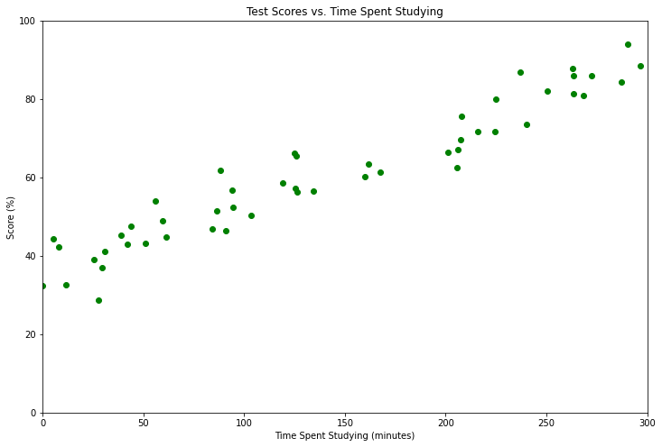
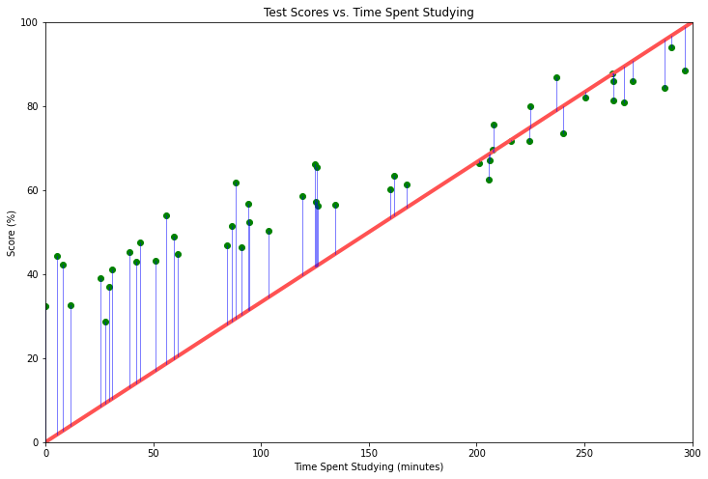
Creating a supervised learning model
This is sometimes called the loss or loss function!
1
2
Choose a model class and define the parameters.
3
Determine a “score” to evaluate your model.
Gather your data.
Example: mean squared error
f(x) = ax + b
f(x) = ax² + bx + c
f(x) = asin(x) + bx² + c
...
f(x) = neural network
4
Optimize your parameters.
Optimizer
5
Evaluate.
Final Model

Slide 4
How does the optimizer work?

Slide 5
Goal
Model with Parameters
E.g. f(x) = ax + b
Optimizer
Parameters that minimize the score
“Score” Function
(Loss Function)
E.g. Mean Squared Error

Slide 6
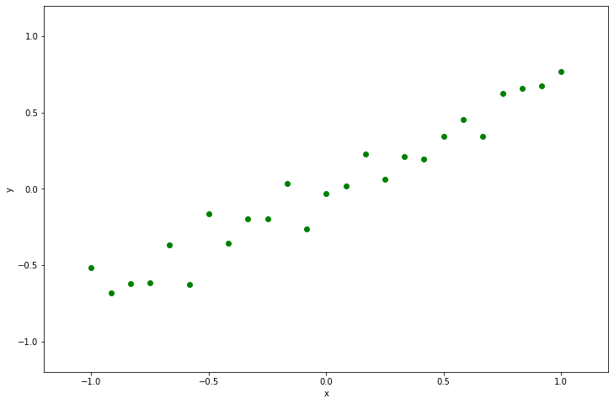
Example
Note: Assuming that b = 0
Goal: Fit a line to this data.
f(x) = ax
Optimizer
Value of a that minimizes the mean squared error
Mean Squared Error

Slide 7
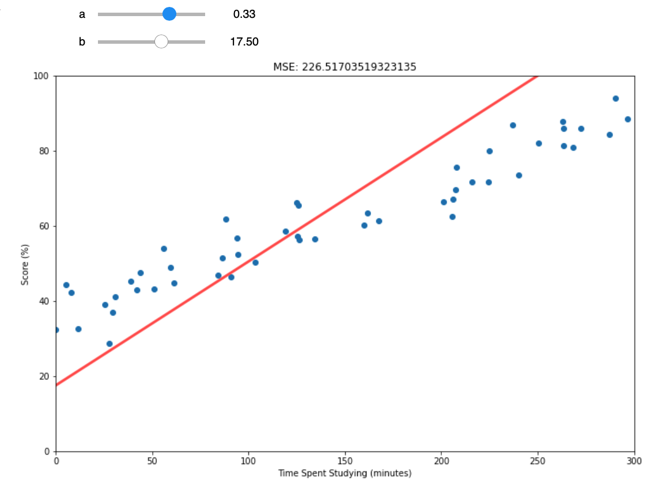
Optimizer 1: “Student Search”
What we did last week!
Pros
Simple
Can use the human brain to make smart decisions
Cons
Time consuming
What if there are 1 million parameters?
What if there are multiple inputs and outputs?

Slide 8
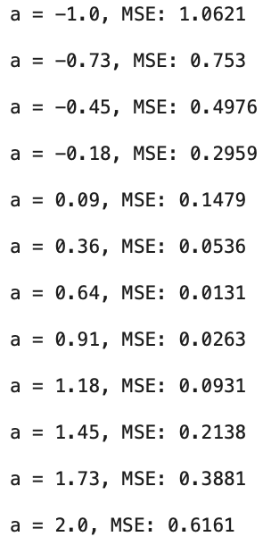
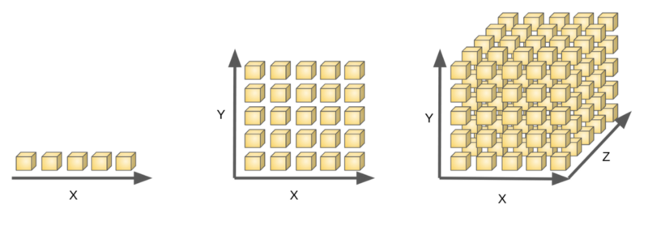
Optimizer 2: Grid Search
a
Pros
Simple
Can be automated (no need for human intervention)
Cons
Not efficient
“Curse of dimensionality”
Small neural network!
1 parameter
2 parameters
3 parameters
200 parameters
...
?
5¹ = 5 points
5² = 25 points
5³ = 125 points
5²⁰⁰ > number of atoms in the universe!

Slide 9
Can we get the best of both worlds?

Slide 10
Optimizer 3: Gradient Descent
Let’s try an optimization problem out from the computer’s point of view. (Exercise 1)
How did you do it?
1
Decide whether to increase or decrease a.
2
Decide how far to move a.
3
Perform the increase or decrease and repeat!
If you followed this process, you were subconsciously performing gradient descent!

Slide 11
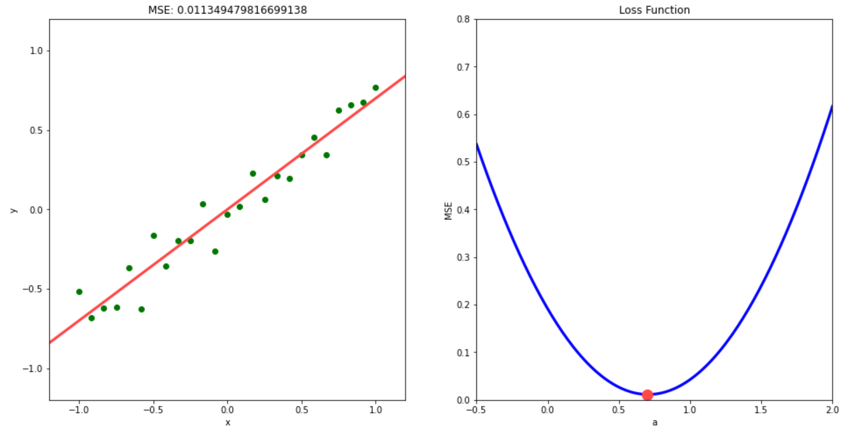
Quick aside: Visualizing the “score”/loss
Demo! (Exercise 2)

Slide 12
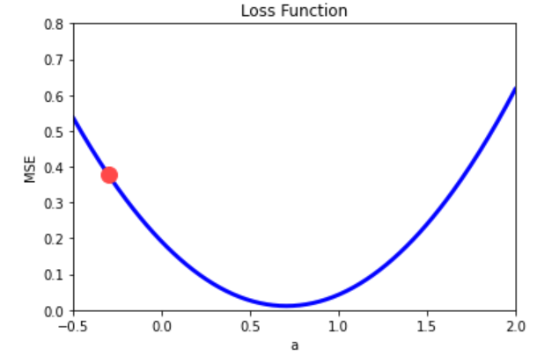
Decide whether to increase or decrease a
1
a = -0.3
mse = 0.37668
a
a = -0.31
mse = 0.38398
a = -0.29
mse = 0.36945

Slide 13
Decide how far to move
2
a = -0.3
mse = 0.37668
a
a = -0.29
mse = 0.36945
Demo! (Exercise 3)
General idea: the amount we move should be proportional to how fast the loss is decreasing.

Slide 14
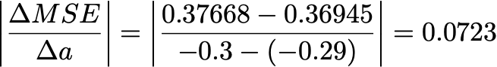
How fast is the loss decreasing?
On other words, if we nudge the parameter a small amount in the direction that it is decreasing, how much does it change?
Mathematically
Geometrically
a = -0.3
mse = 0.37668
a
It’s just the slope!
a = -0.29
mse = 0.36945
Rise
Run

Slide 15
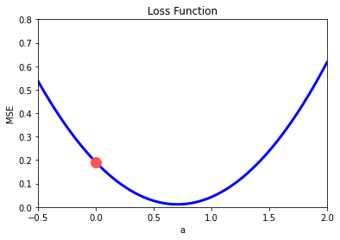
How fast is the loss decreasing?
In other words, if we nudge the parameter a small amount in the direction that it is decreasing, how much does it change?
Mathematically
Geometrically
a = -0.3
mse = 0.37668
a
It’s just the slope!
a = -0.29
mse = 0.36945
Rise
Run

Slide 16
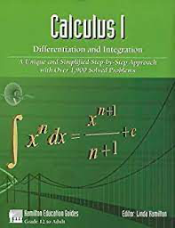
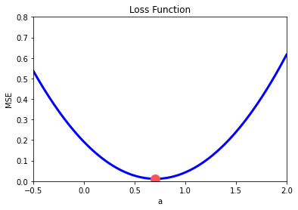
How fast is the loss decreasing?
On other words, if we nudge the parameter a small amount in the direction that it is decreasing, how much does it change?
Mathematically
“derivative”
“gradient”
Geometrically
a = -0.3
mse = 0.37668
a
It’s just the slope!
a = -0.29
mse = 0.36945
Rise
Run

Slide 17
Decide how far to move
2
a = -0.3
mse = 0.37668
a = -0.2277
mse = 0.32605
0.0723
a
step size = (learning rate)(slope)
Our first example of a hyperparameter!
step size = (1.0)(0.0723) = 0.0723

Slide 18
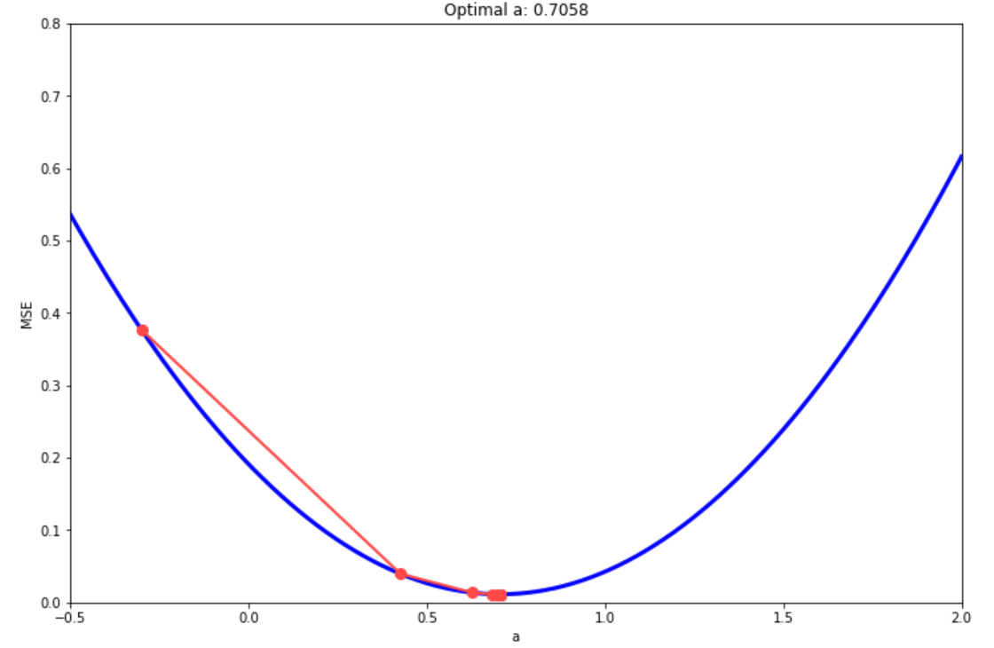
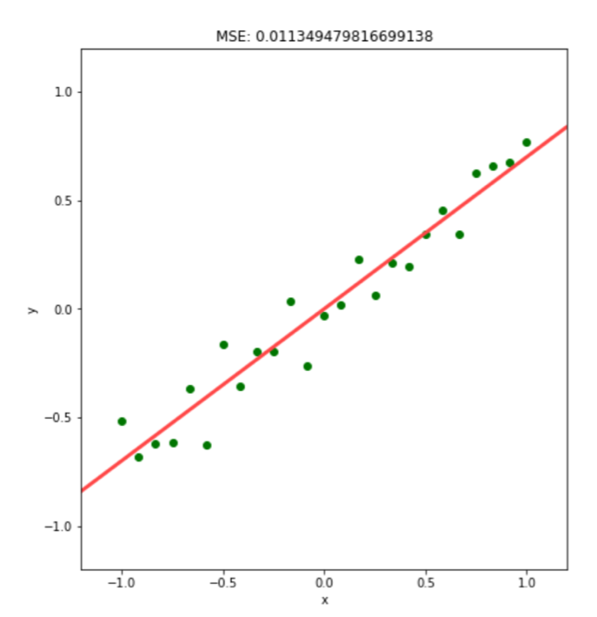
Repeat!
3
Try it out! (Exercise 4)

Slide 19
We can follow the same process even if we have to find multiple optimal parameters!
This allows us to do much more than just fit some lines and parabolas!

Slide 20
Neural networks

Slide 21
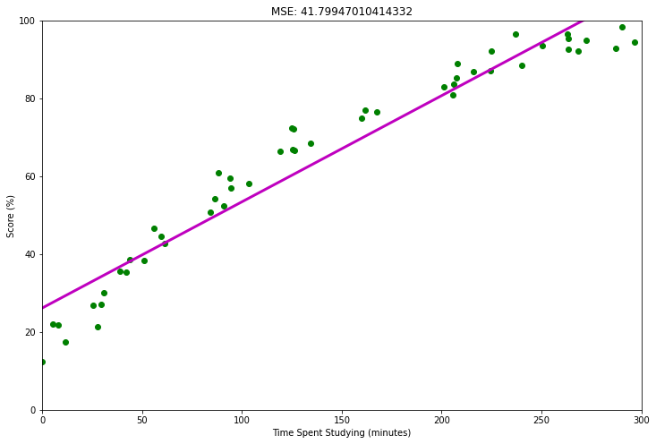
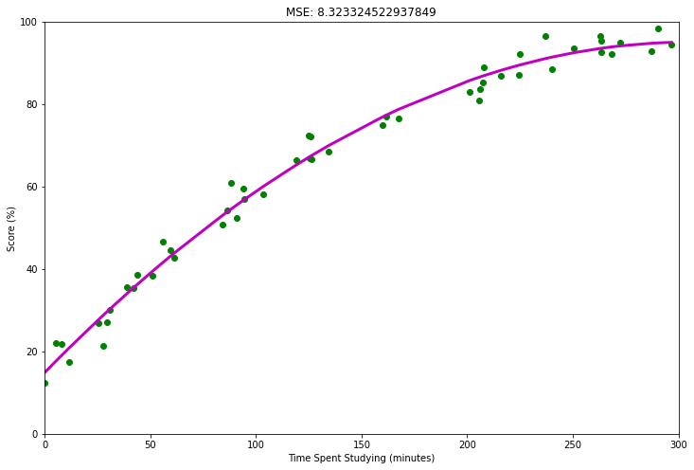
From last time
MSE: 41.799
MSE: 8.323
f(x) = ax + b
f(x) = ax² + bx + c
Complex data requires more expressive models.

Slide 22

Aircraft taxiing system
What are the inputs and outputs in this case?
Outputs
Inputs
Crosstrack error
Pixel values
Model
Heading error
The inputs and outputs are quite complex!
Do you think a line would work in this case? How can we pick a model class?

Slide 23
What if we could make a model that could express any function we want?

Slide 24
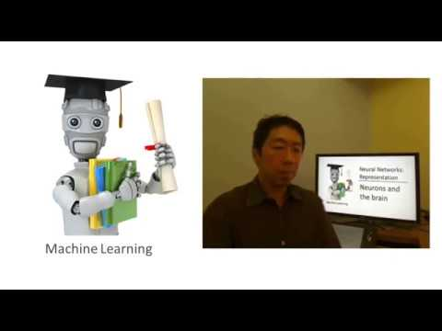
Inspiration: the human brain

Slide 25
How does the human brain work?

Slide 26
Artificial Neural Networks
Extra info from 3blue1brown: https://www.youtube.com/watch?v=aircAruvnKk&t=440s

Slide 27
The equation behind neural networks
Activation(w₁x₁ + w₂x₂ + b₁)
Outputs
Inputs
w₁
y = w₇Activation(w₁x₁ + w₂x₂ + b₁)
+ w₈Activation(w₃x₁ + w₄x₂ + b₂)
+ w₉Activation(w₅x₁ + w₆x₂ + b₃)
+ b₄
w₂
x₁
Activation(w₃x₁ + w₄x₂ + b₂)
w₇
w₃
w₈
y
w₄
x₂
w₉
This is a function with parameters just like a line and a parabola!
w₅
w₆
Activation(w₅x₁ + w₆x₂ + b₃)

Slide 28
We can stack layers!
x₁
y
x₂
The network architecture for your project will be up to you!

Slide 29
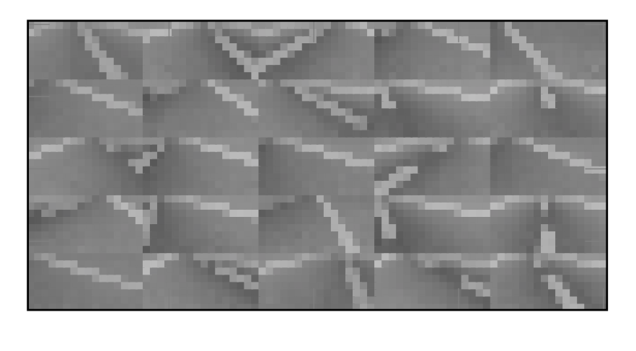
Creating a neural network model
1
Gather your data.
2
Choose a neural network architecture.
3
Determine a loss function.
Example: mean squared error
Number of layers
Nodes per layer
4
Optimize your parameters.
Optimizer
5
Evaluate.
Final Model

Slide 30
Questions?

